Slide 1


Instructor Resources
Chapter 16 Figures
Cover photo: BeautyStock – stock.adobe.com.

Slide 2
Chapter 16
Weather Considerations for Turbine Pilots

Slide 3
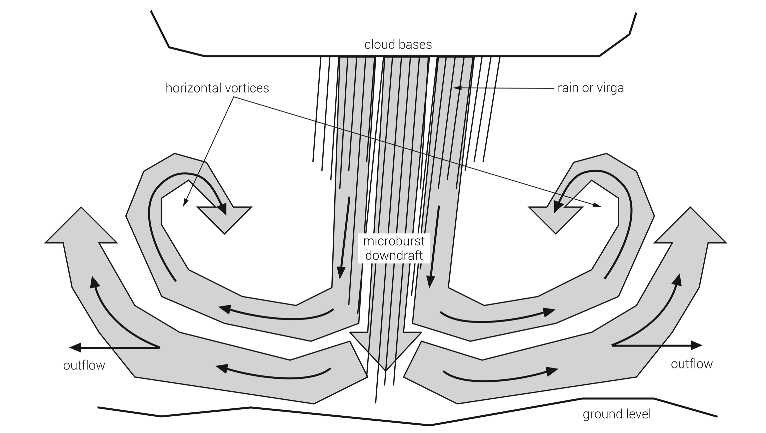
FIGURE 16.1
Microburst.

Slide 4
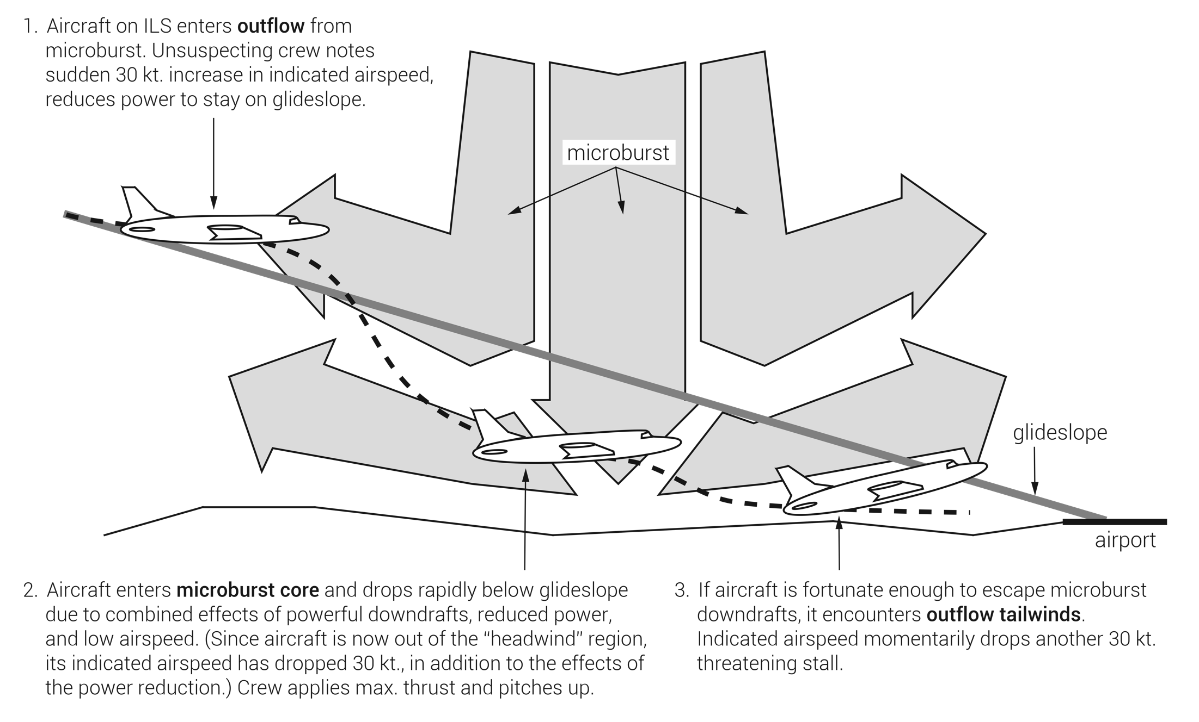
FIGURE 16.2
Effects of a microburst on an aircraft.

Slide 5
Pilot Wind Shear Guide
Wind Shear Recognition:
Recognition of wind shear encounter is difficult and is usually complicated by marginal weather.
Time available for recognition and recovery is short (as little as 5 seconds).
Flight crew coordination is essential for prompt wind shear recognition and recovery.
Suspected Wind Shear Indications:
Indicated airspeed fluctuations in excess of 15 knots.
Vertical speed variations in excess of 500 fpm.
Pitch attitude excursions of 5° or more.
Glideslope deviations in excess of one dot high or low.
Unusual thrust lever position or excessive autothrottle movement.
Pilot Technique:
Flight crew readiness and commitment to respond to a wind shear warning.
Flight path must be controlled with pitch attitude (unusual stick forces may be required as a result).
Lower than normal airspeed may have to be accepted to counter lift loss.
FIGURE 16.3
Wind shear recognition and pilot recovery technique.

Slide 6
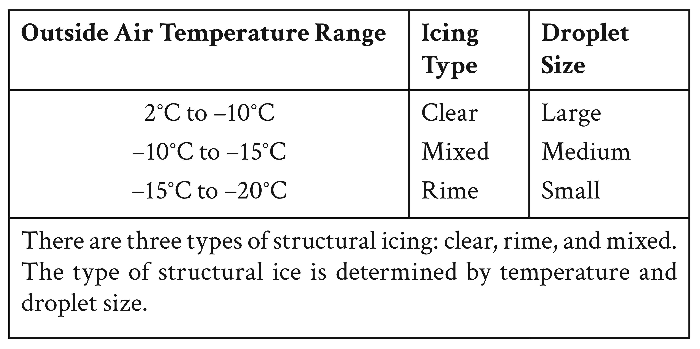
FIGURE 16.4
Types of structural icing.

Slide 7
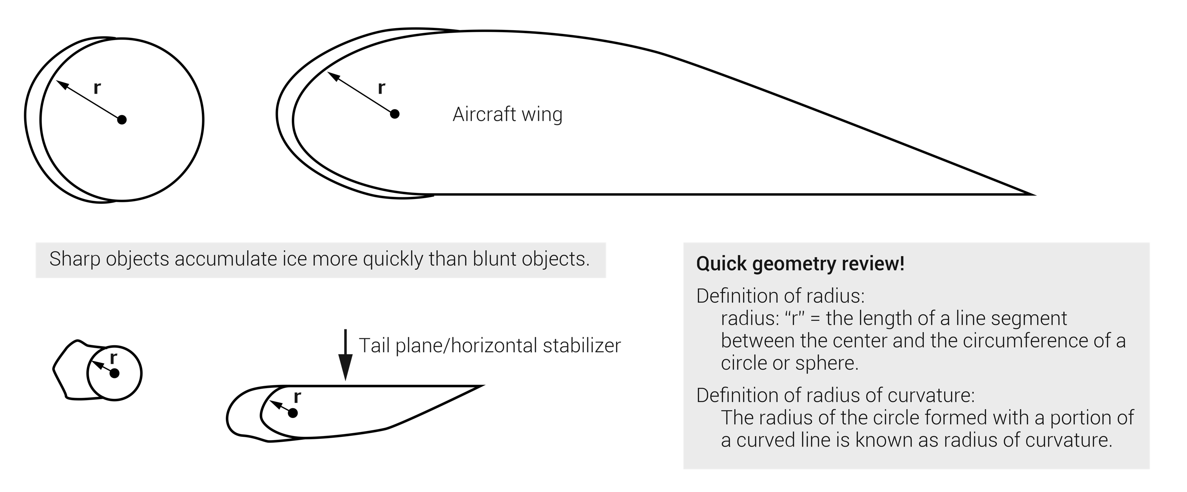
FIGURE 16.5
More ice forms on surfaces with a shorter radius of curvature.

Slide 8
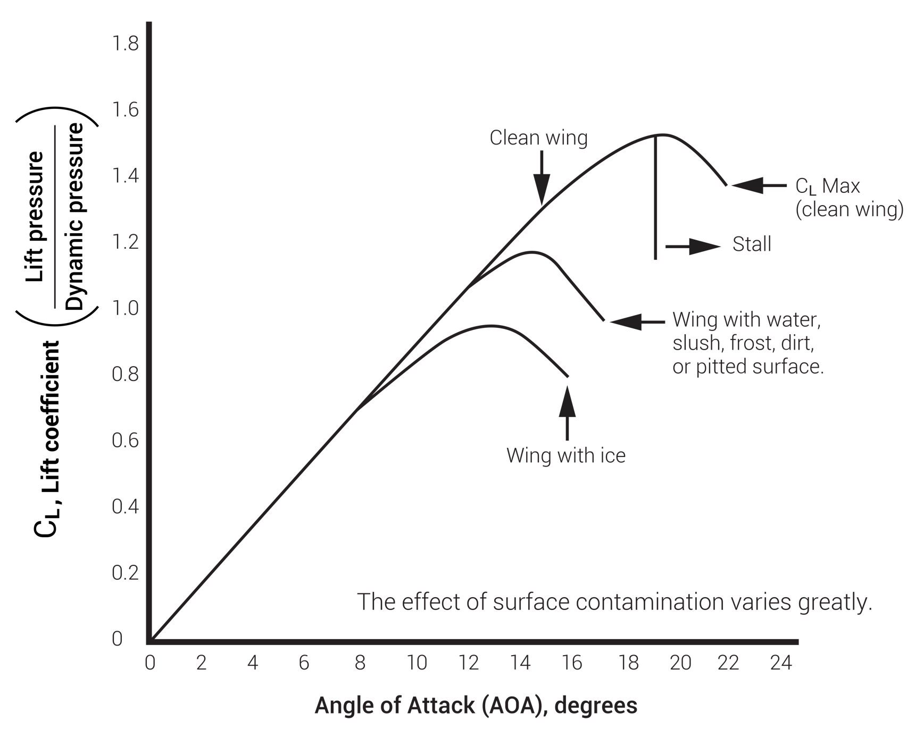
FIGURE 16.6
The effect of surface contamination on lift.

Slide 9
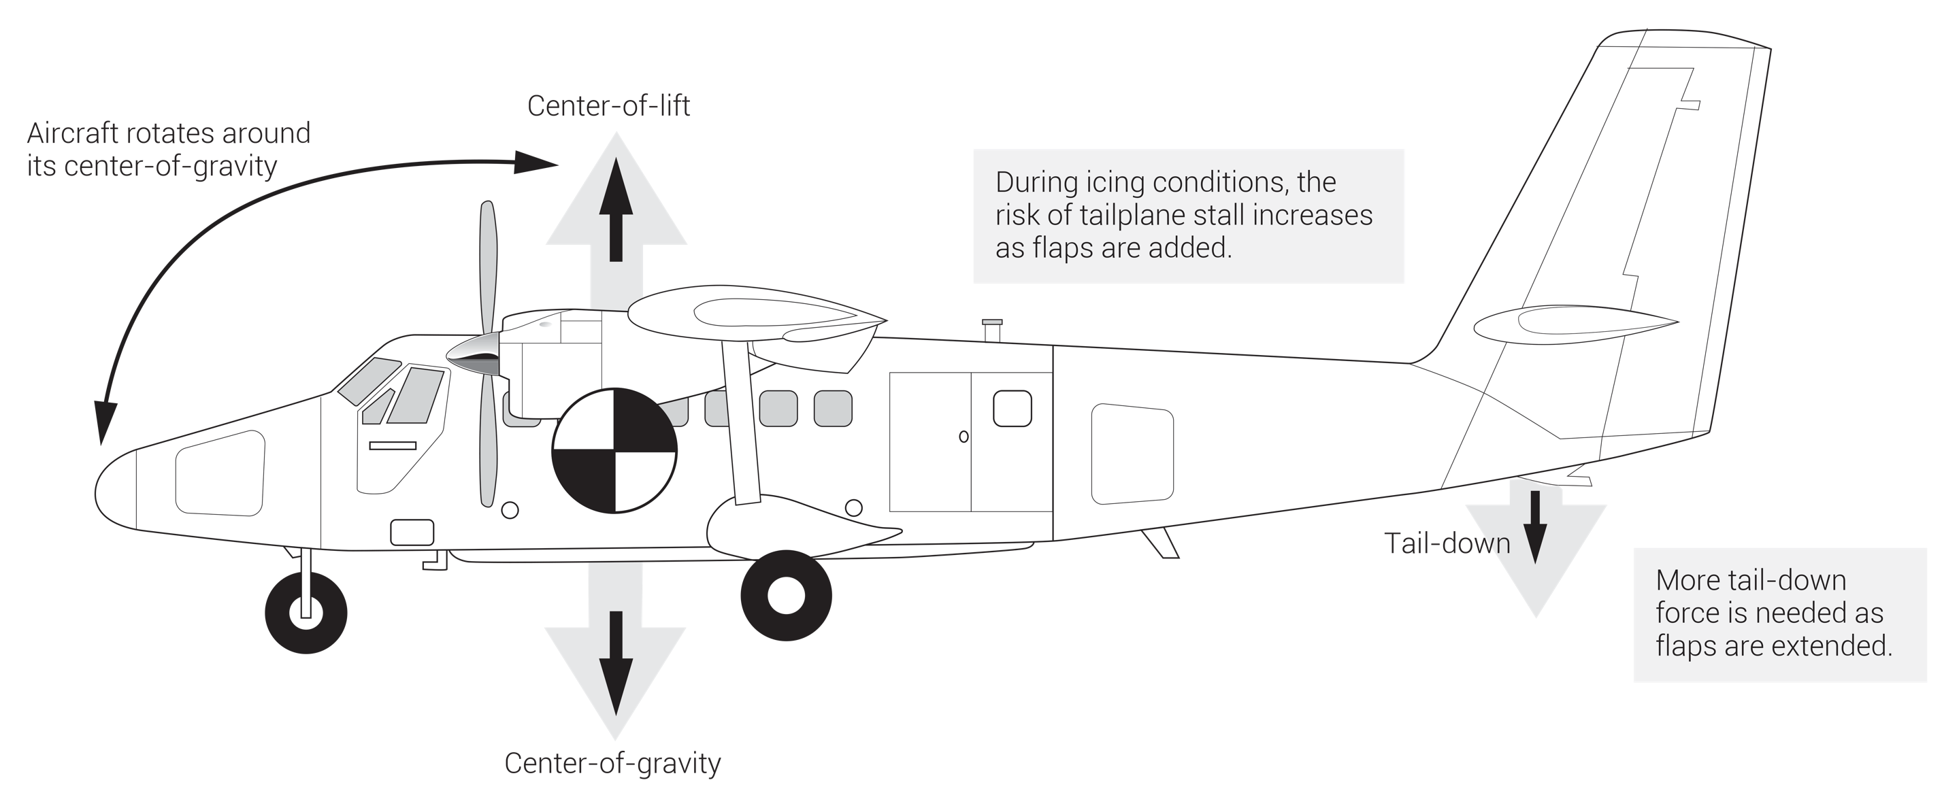
FIGURE 16.7
Tailplane icing.

Slide 10
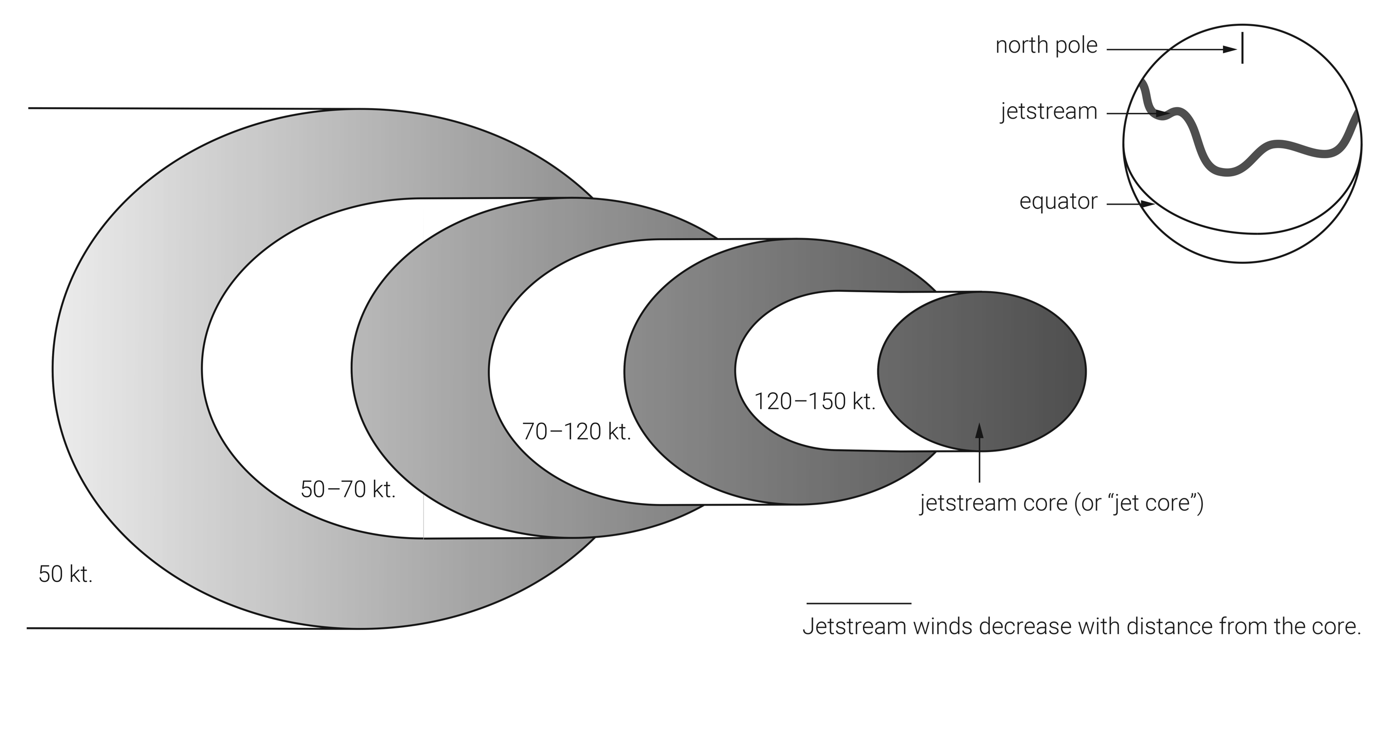
FIGURE 16.8
Jetstream.

Slide 11
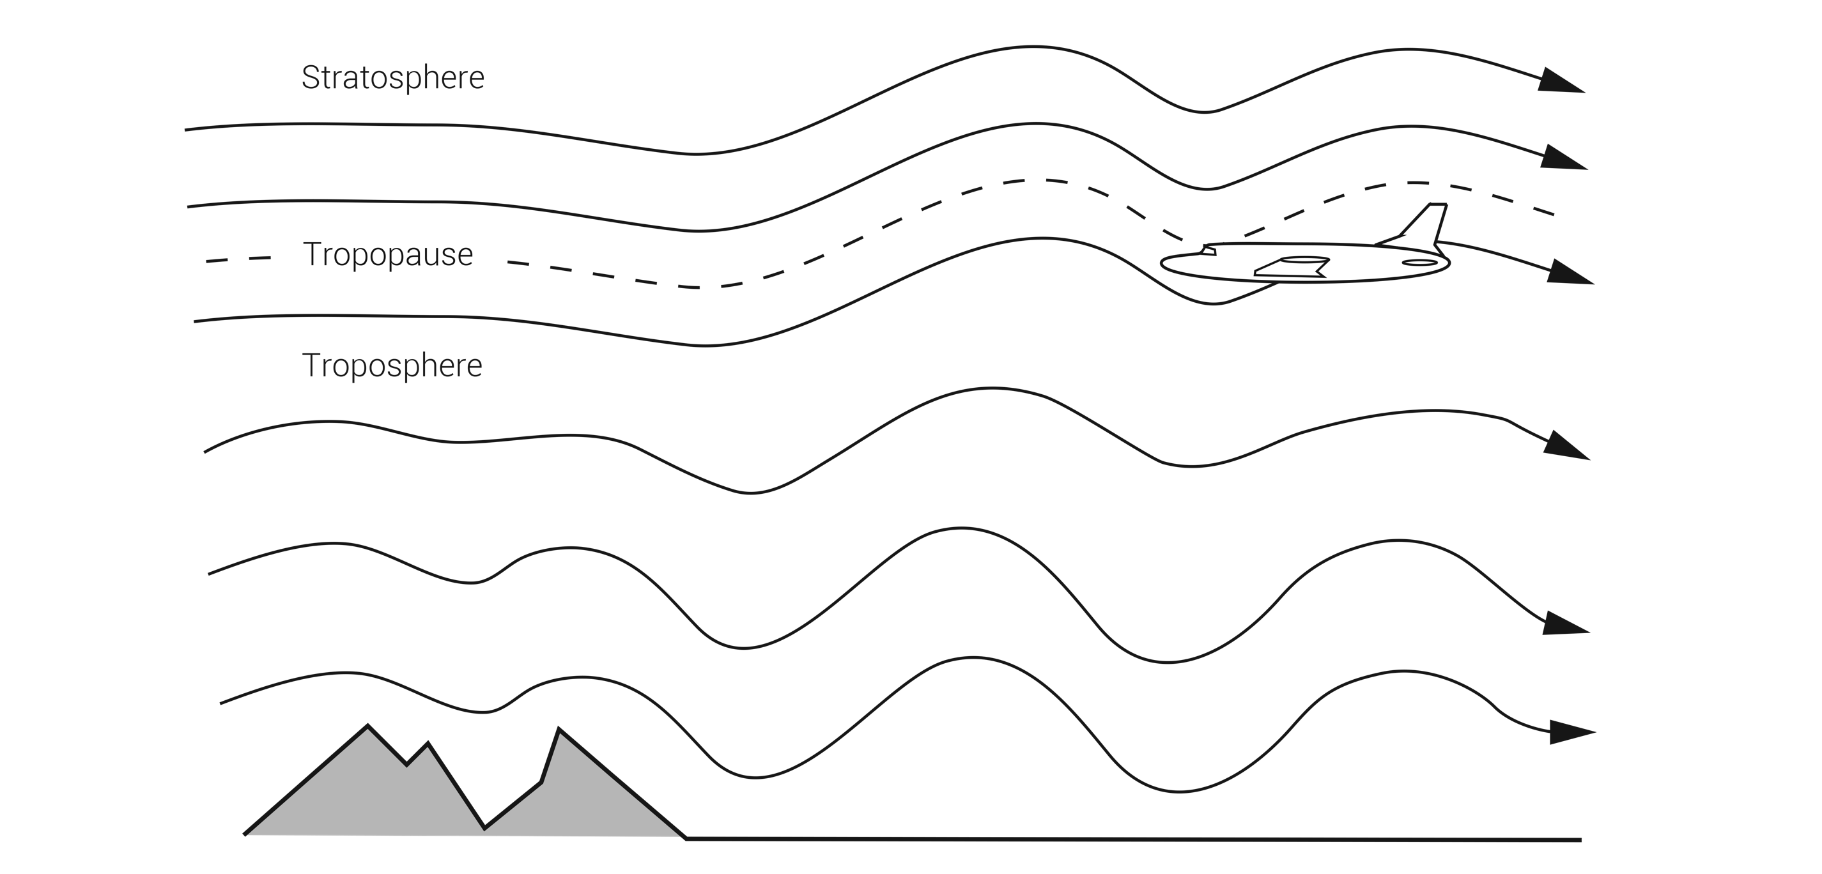
FIGURE 16.9
Mountain wave.

Slide 12
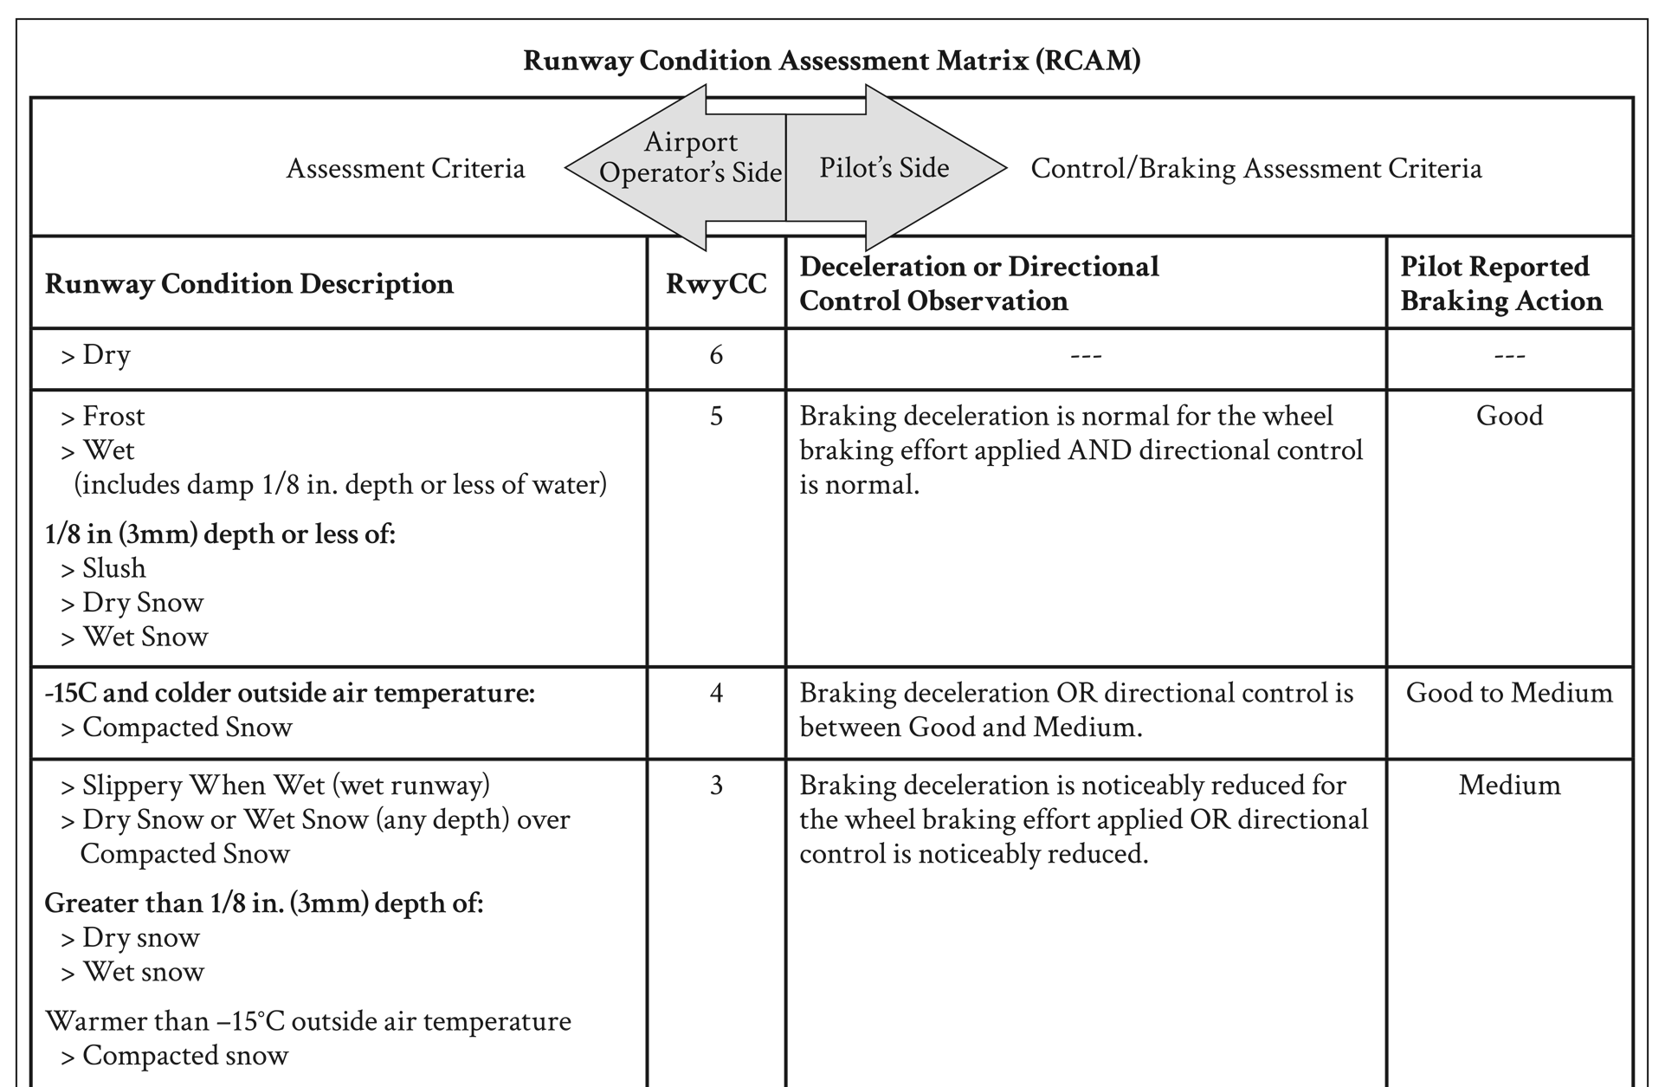
(continued)
FIGURE 16.10 (1 of 2)
Runway Condition Assessment Matrix (RCAM).

Slide 13
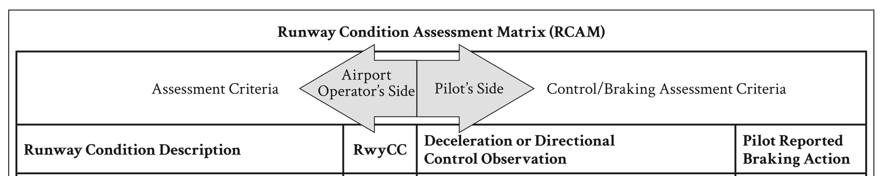
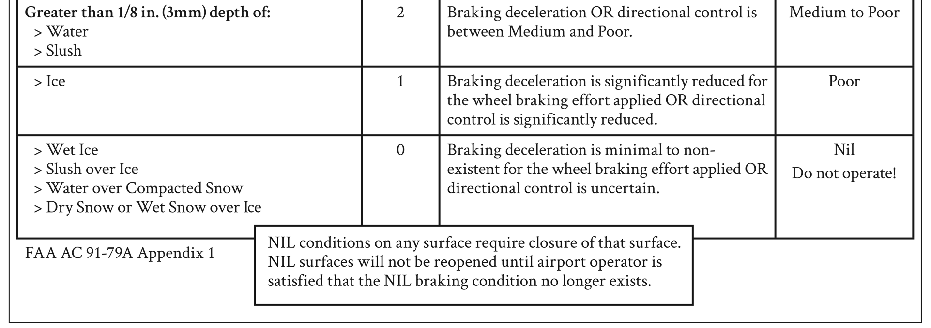
FIGURE 16.10 (2 of 2)
Runway Condition Assessment Matrix (RCAM).

Slide 14
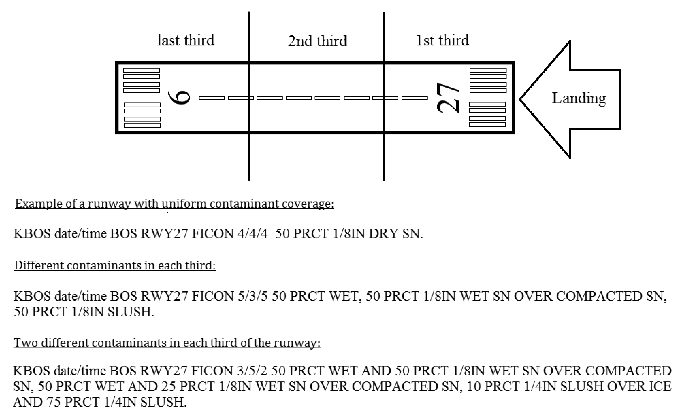
FIGURE 16.11
Runway condition reporting.

